Slide 1

Art Bible: Zombie Platformer
By James Webster

Slide 2
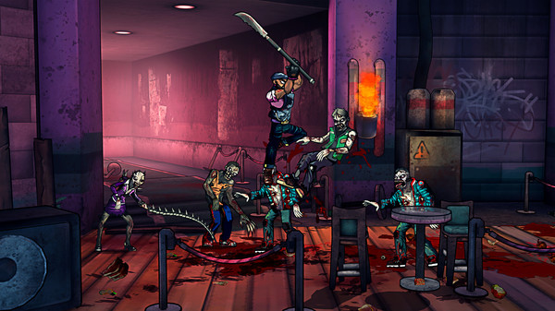
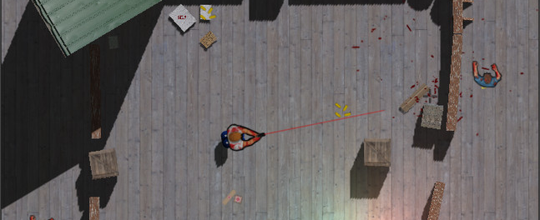
Overview: Zombie Platformer
You are on a floating platform high in the sky and are getting attacked by zombies.
You only have a gun and the surrounding hazards to defend yourself with.
Kill enough zombies to trigger the last wave, and survive the incoming horde to complete the level.

Slide 3
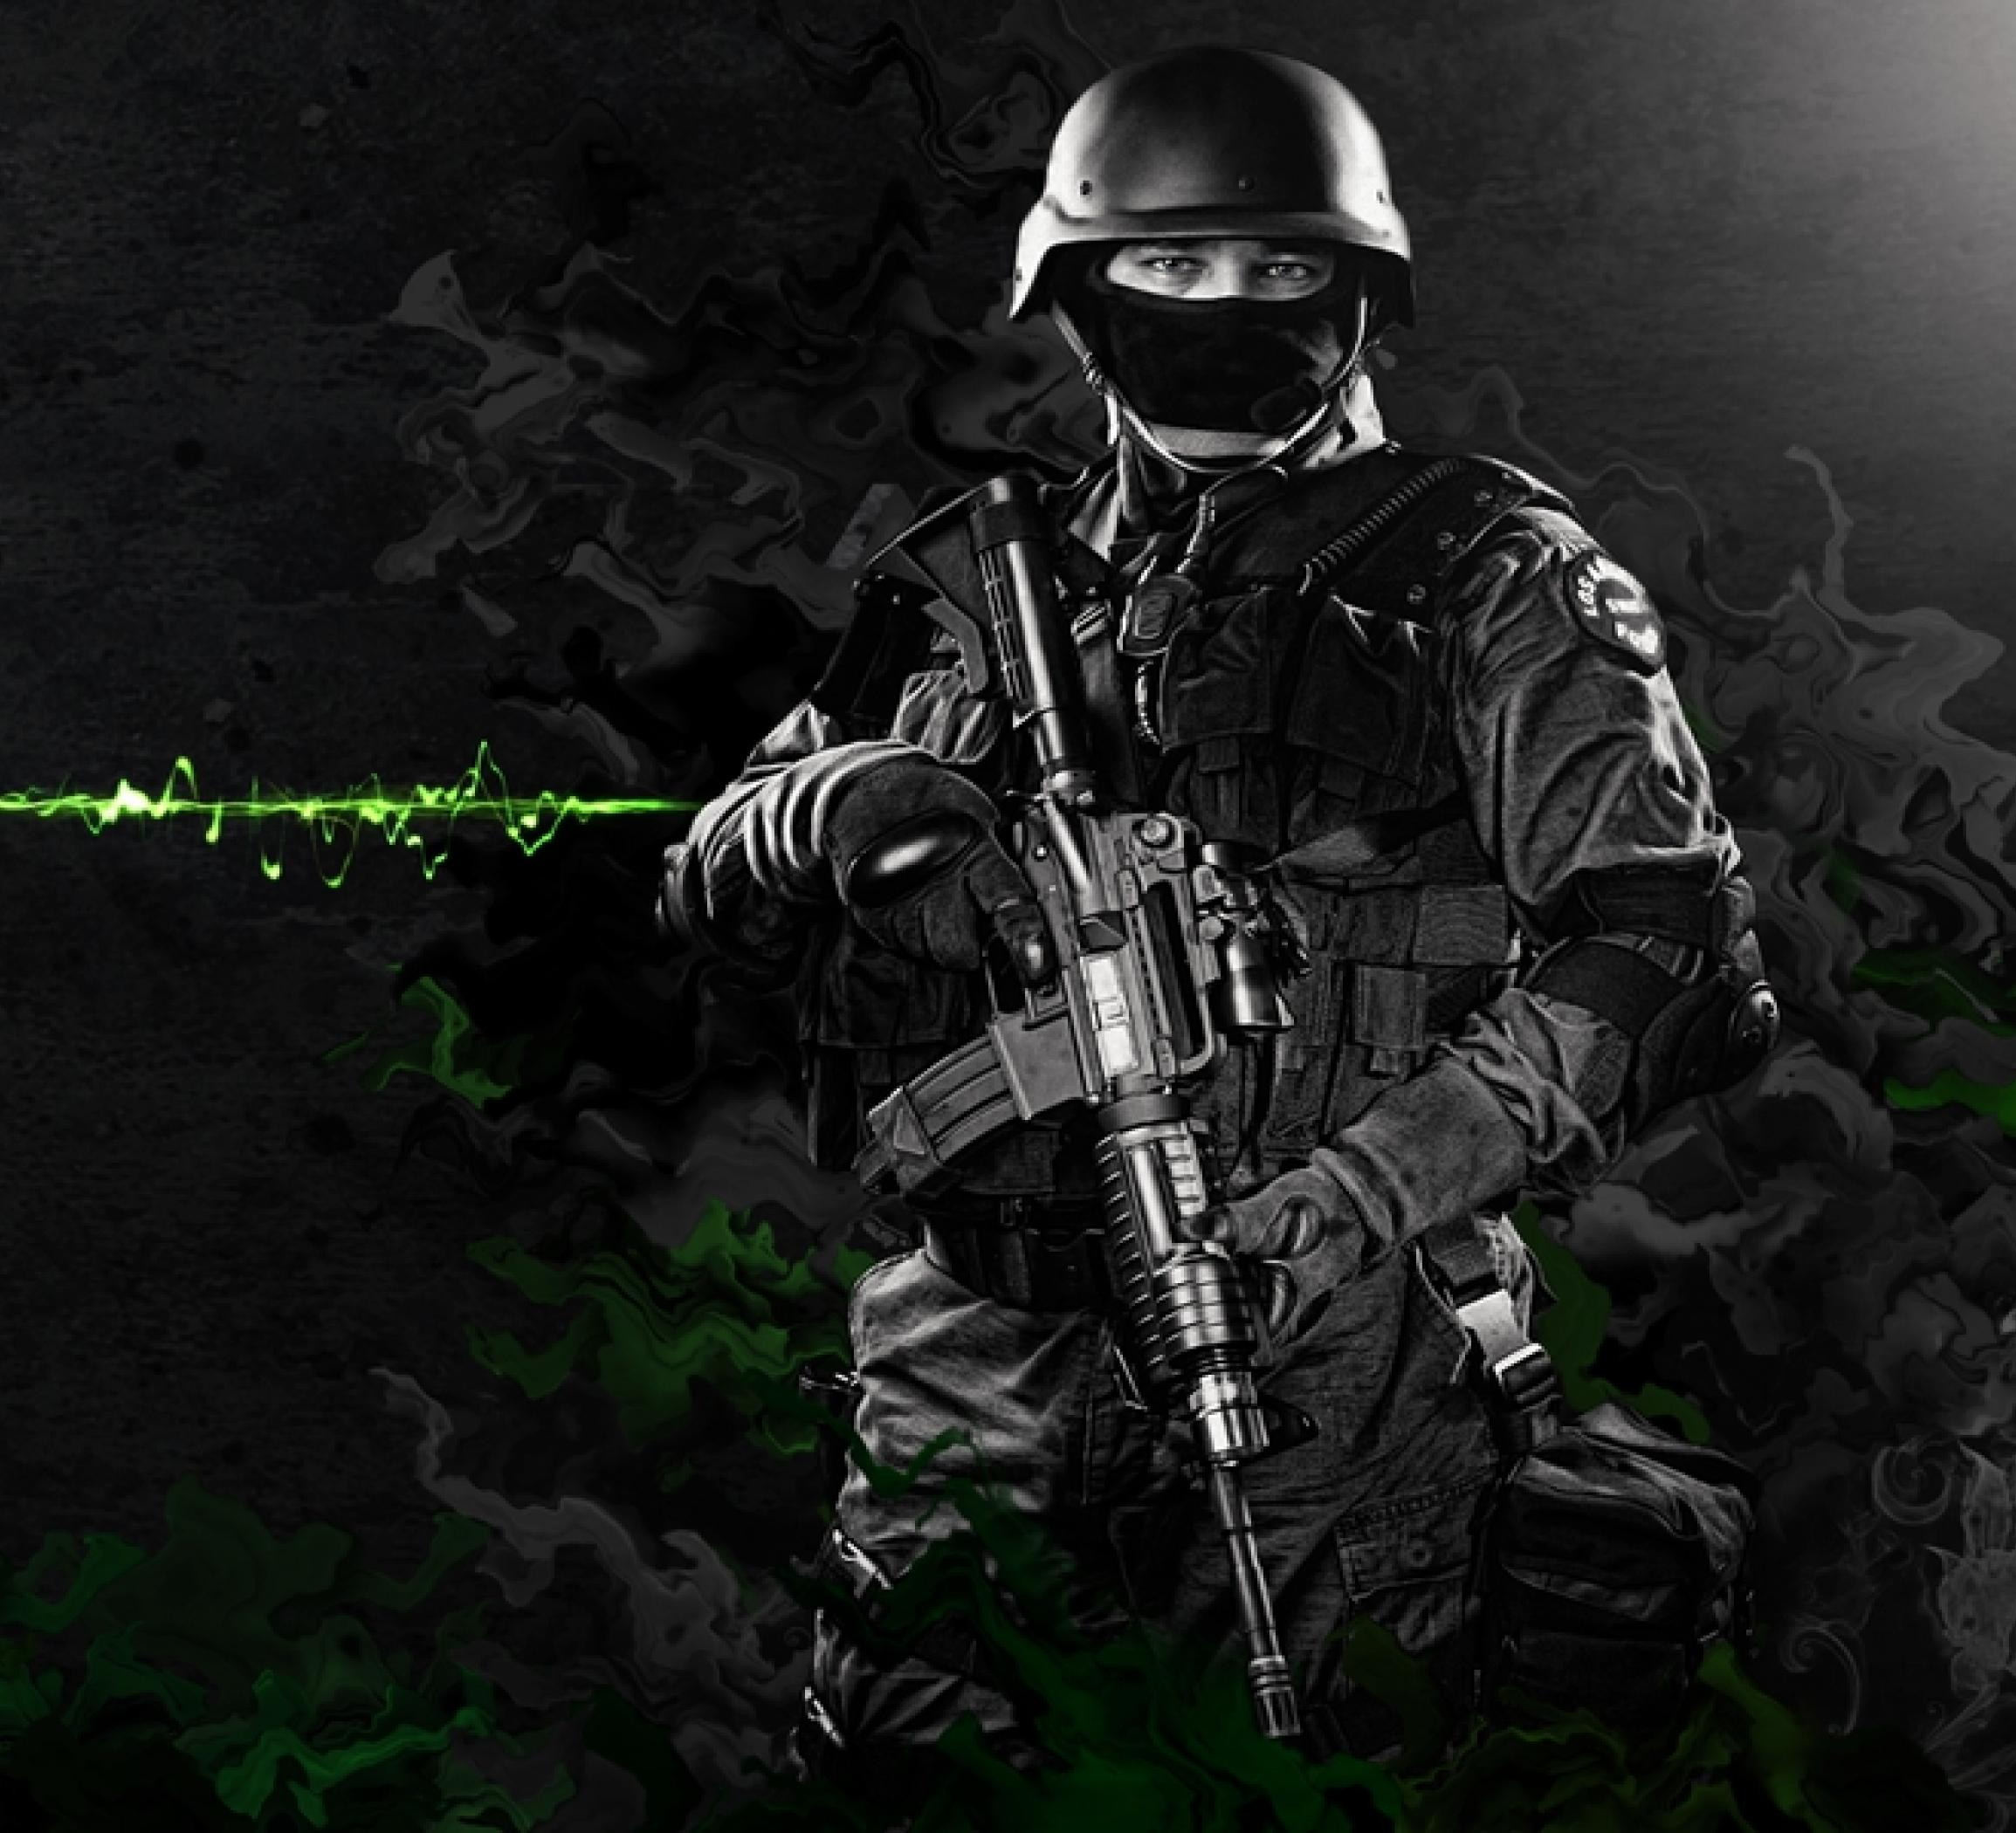
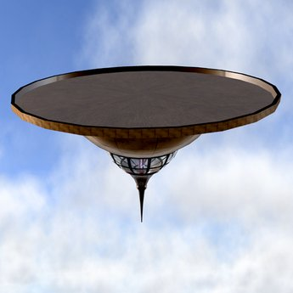
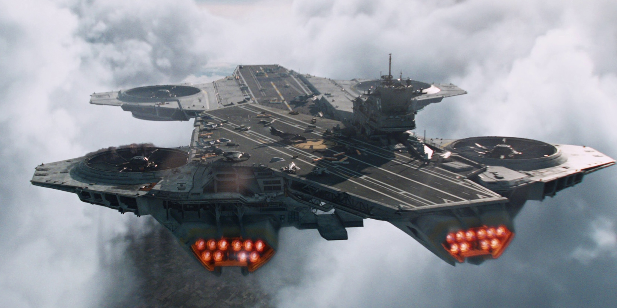
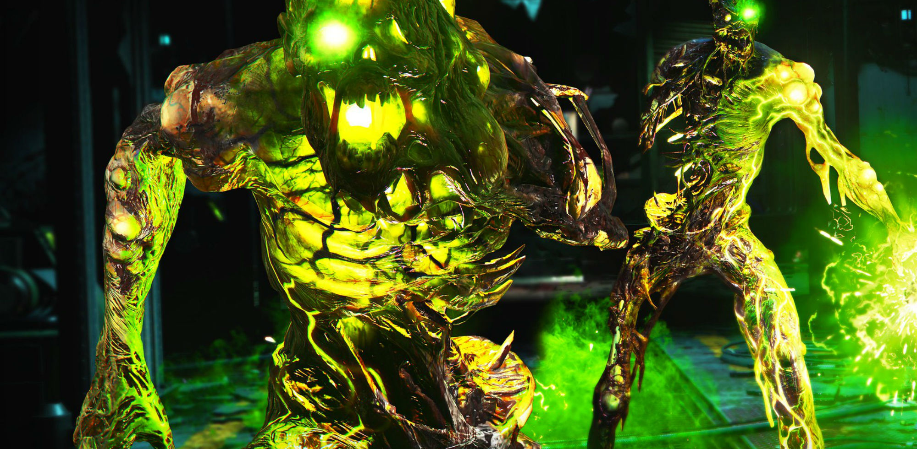
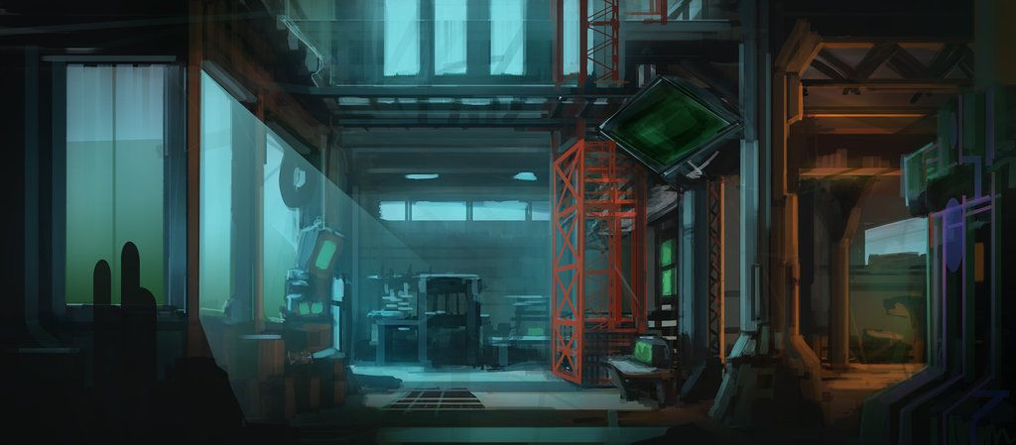
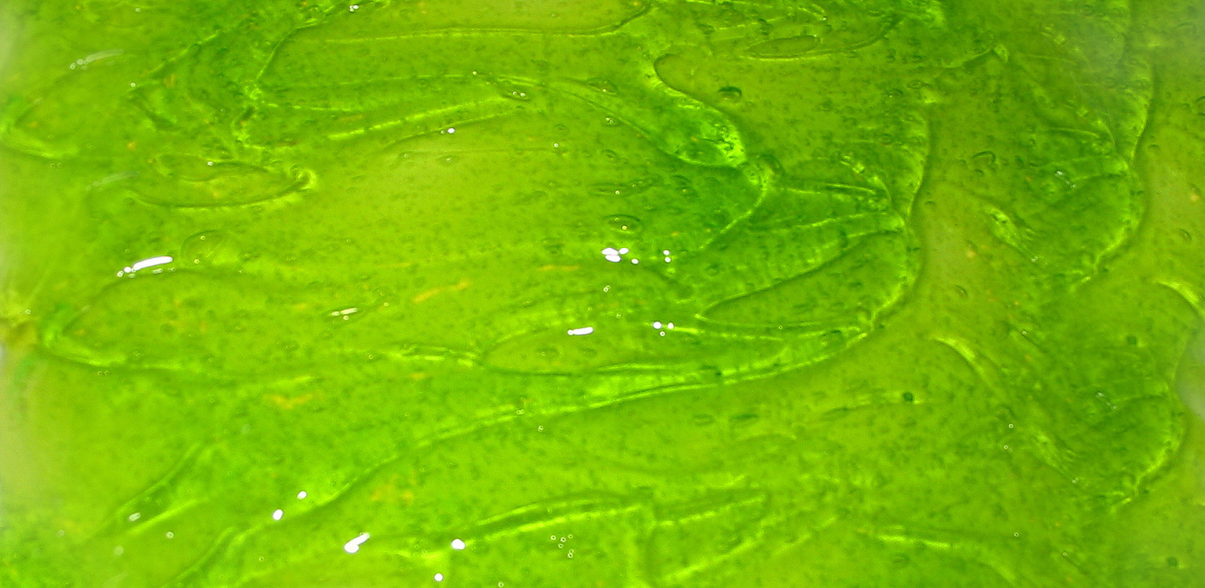
Mood Board

Slide 4
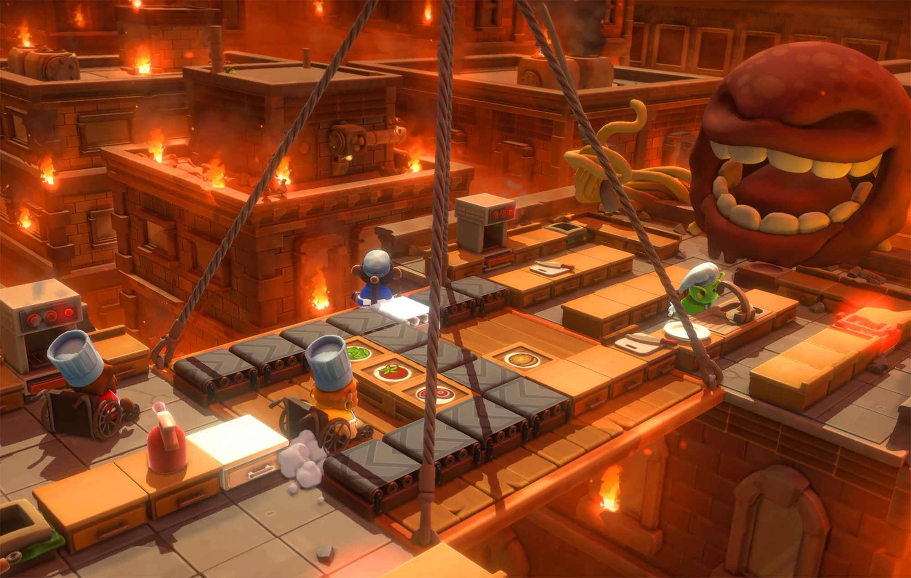
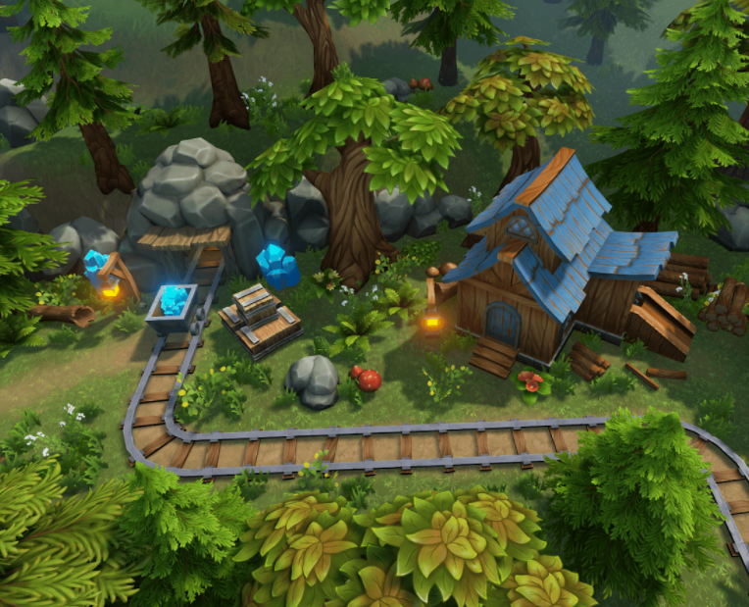
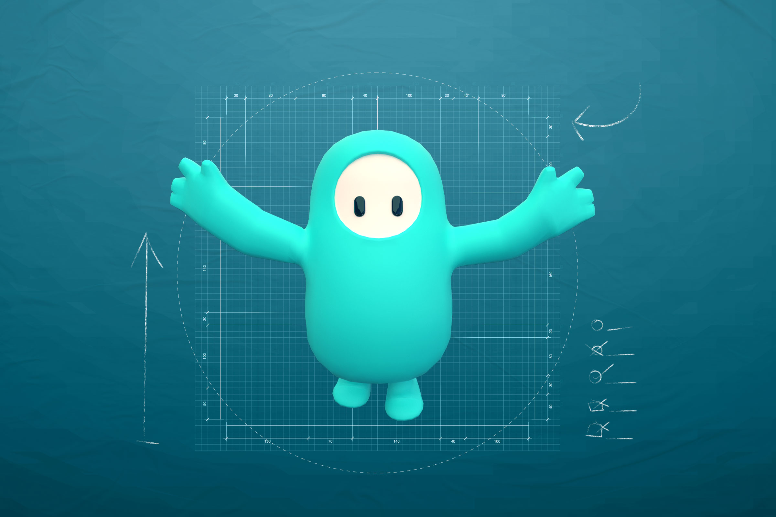
Project Art Style
Hand painted style with few details
Low-poly characters

Slide 5
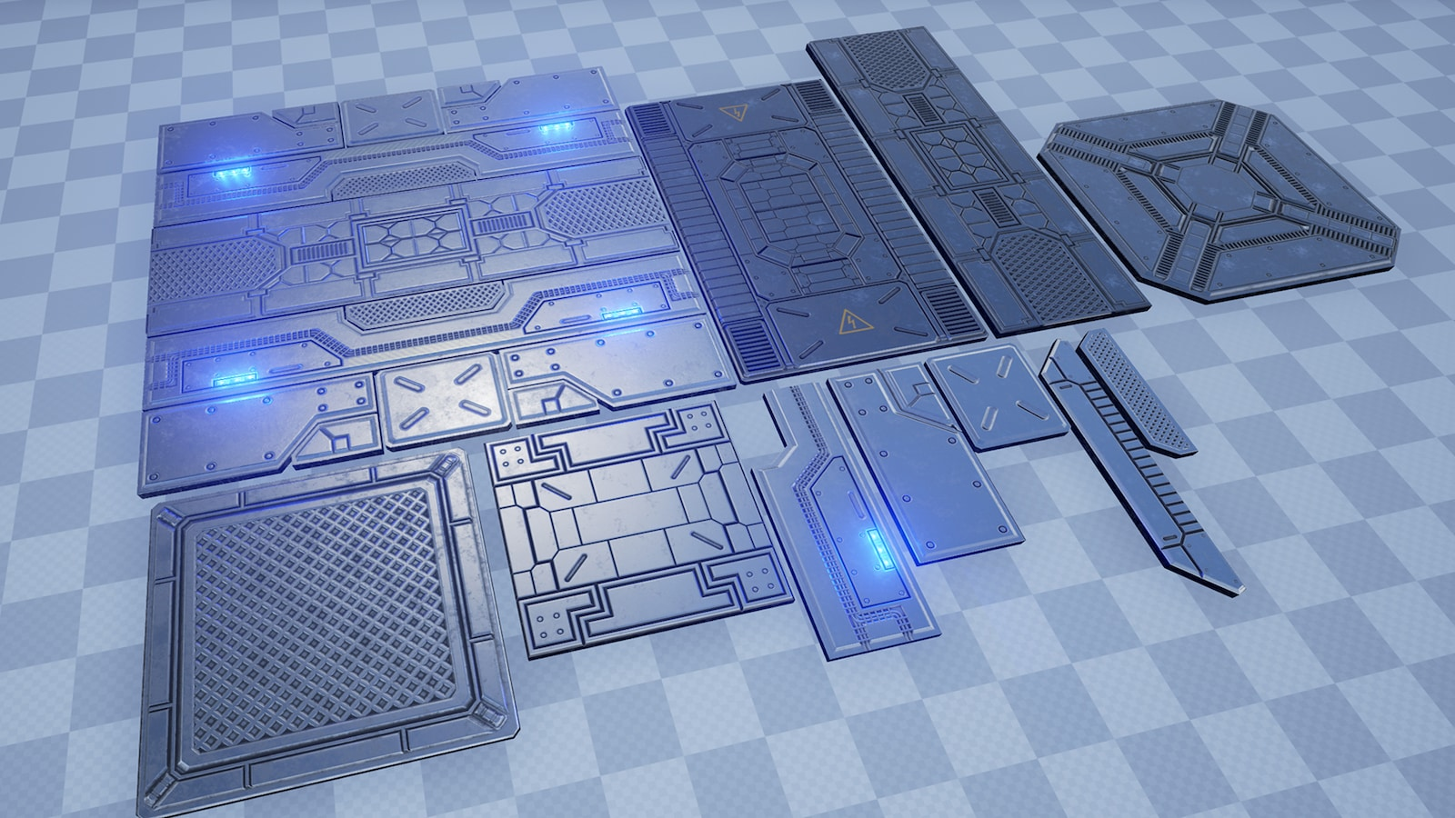
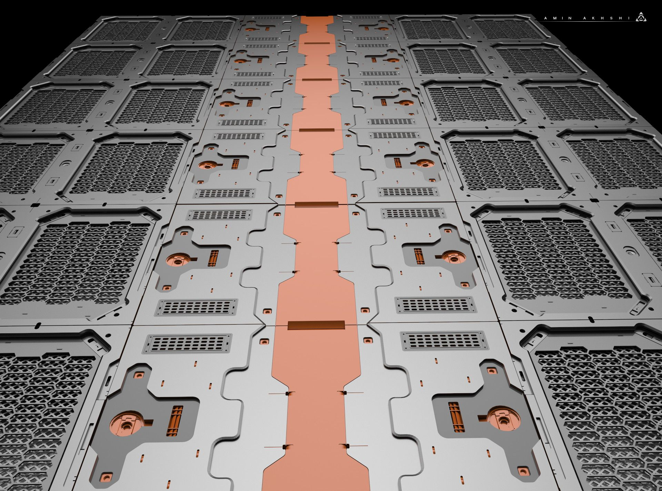
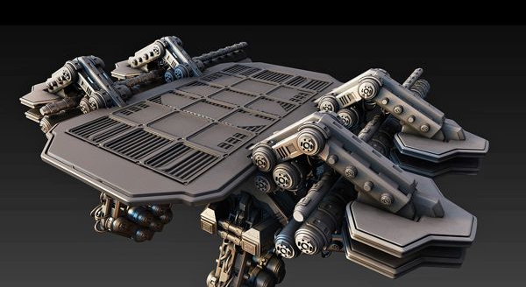
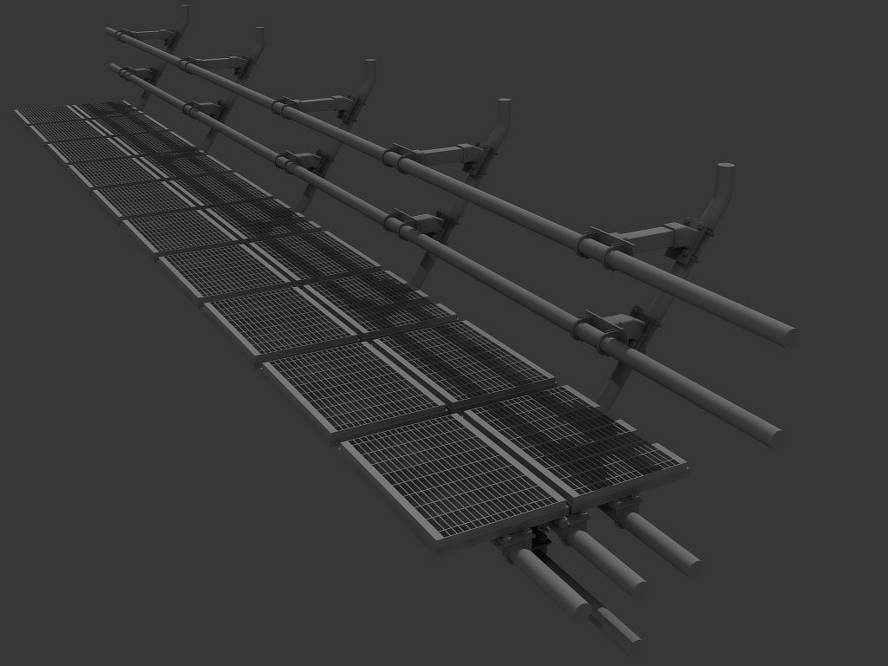
Environment/Atmosphere
Metal textured assets with sci-fi styled aesthetics.
Assets include floors, guard rails and platforms

Slide 6
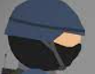
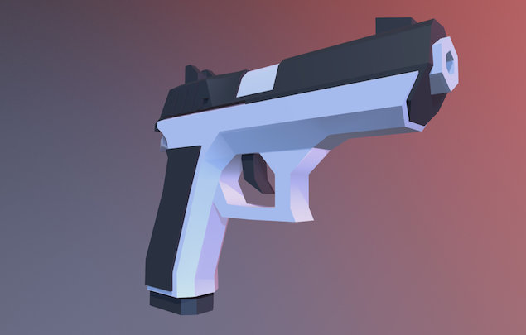
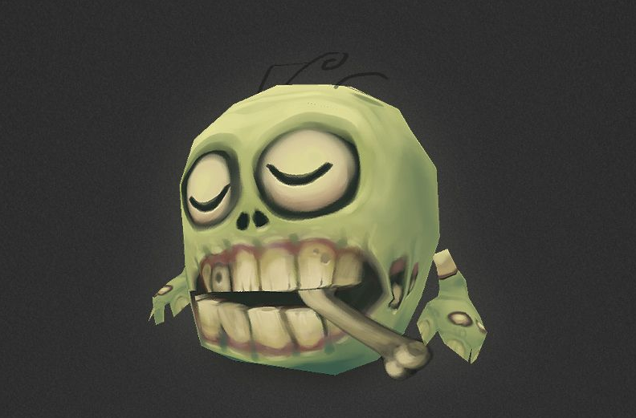
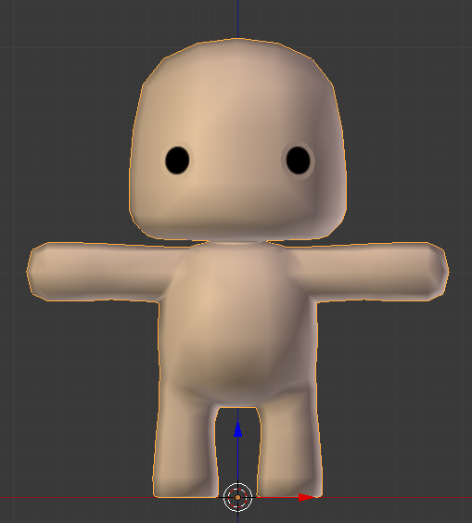
Characters
Helmet on player head
Low-poly gun held by player
Zombie facial features
Consistent body typing across all characters
Large Head on smaller/plump body

Slide 7
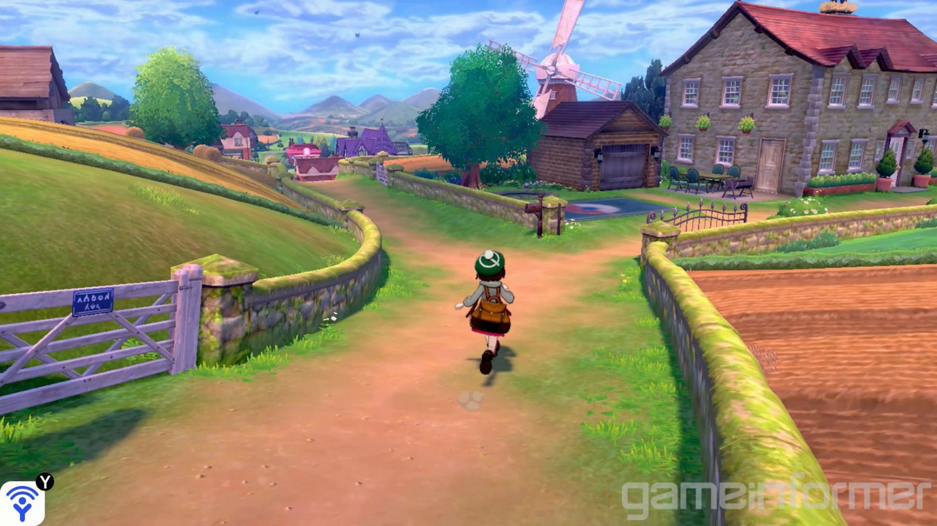
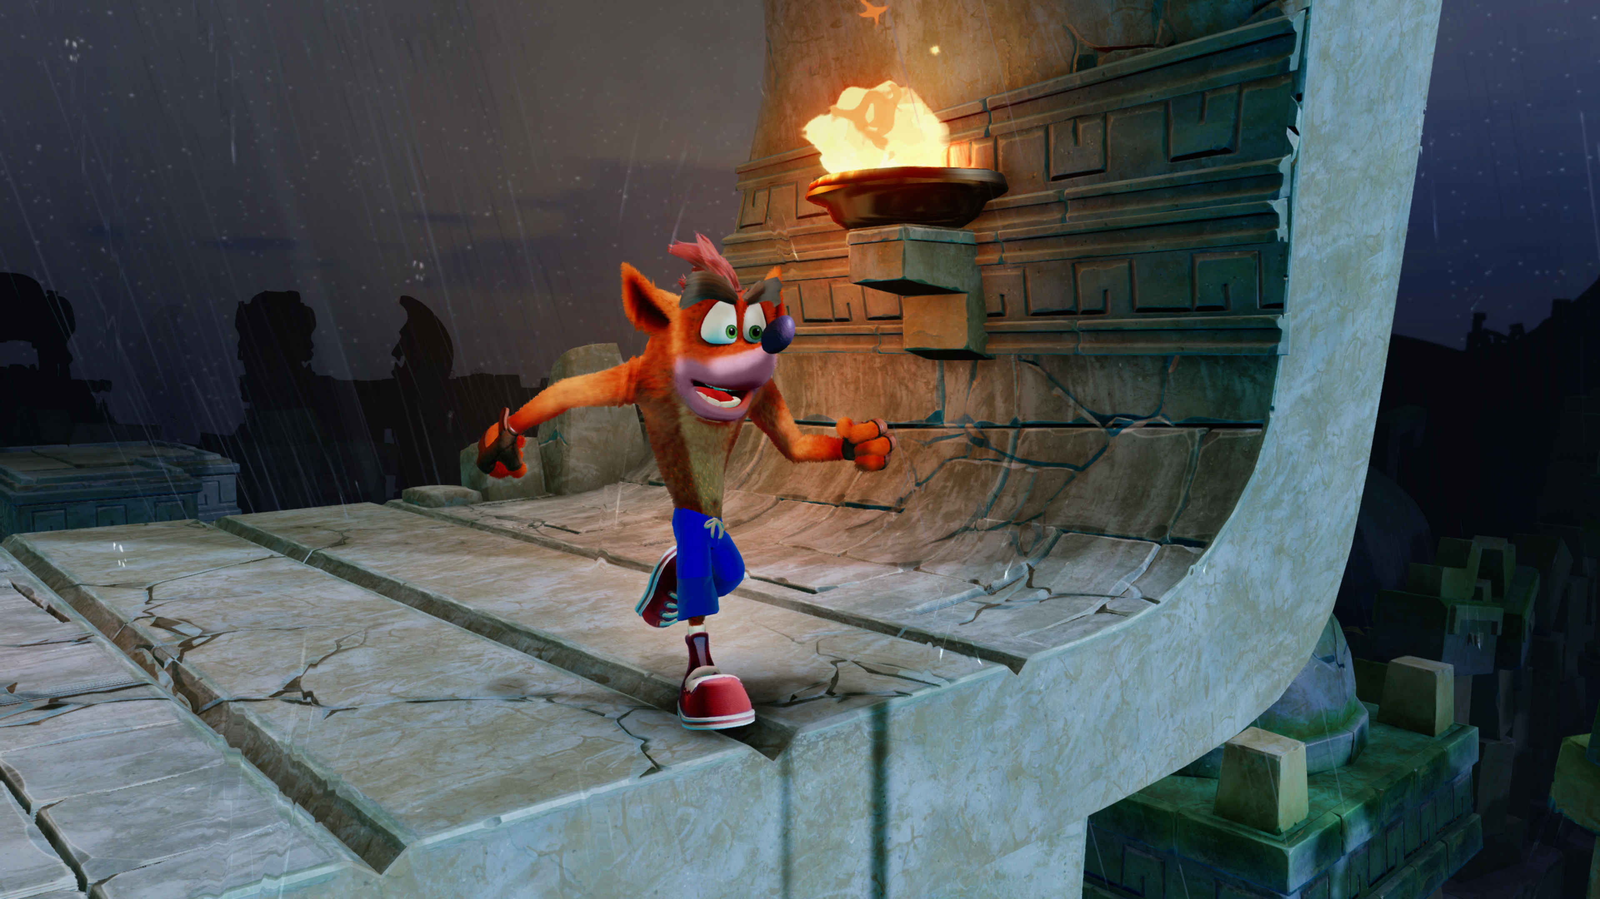
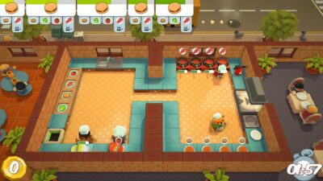
Models/Level of Detail (LOL)
Low-poly character models
‘Low-quality’ realistic with cartoon-like details for the environment
Maintains hand-painted art style

Slide 8
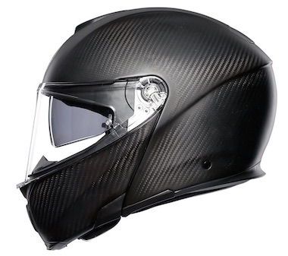
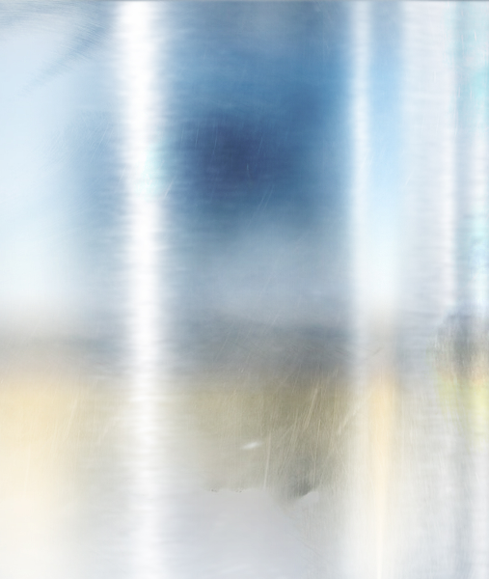
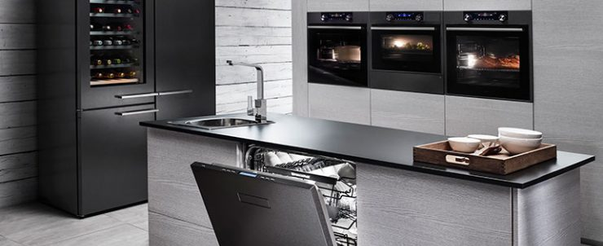
Textures
Smooth reflective/metal texture on most surfaces
NO reflection on characters

Slide 9
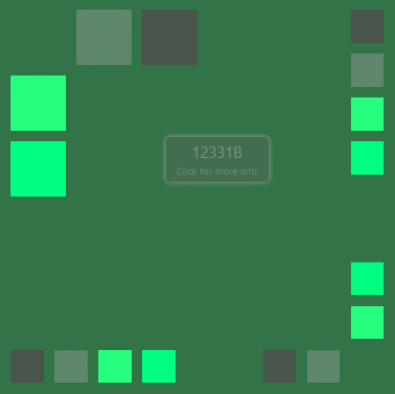
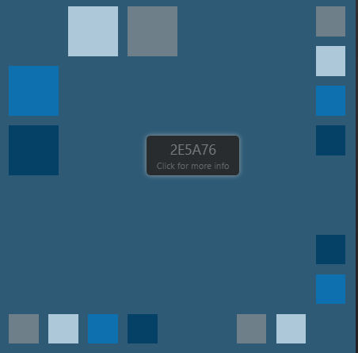
Colour Palette
Dirty/neon green and black FOR ASSETS AND CHARACTERS
Clean blue for sky and environment outside of the level

Slide 10
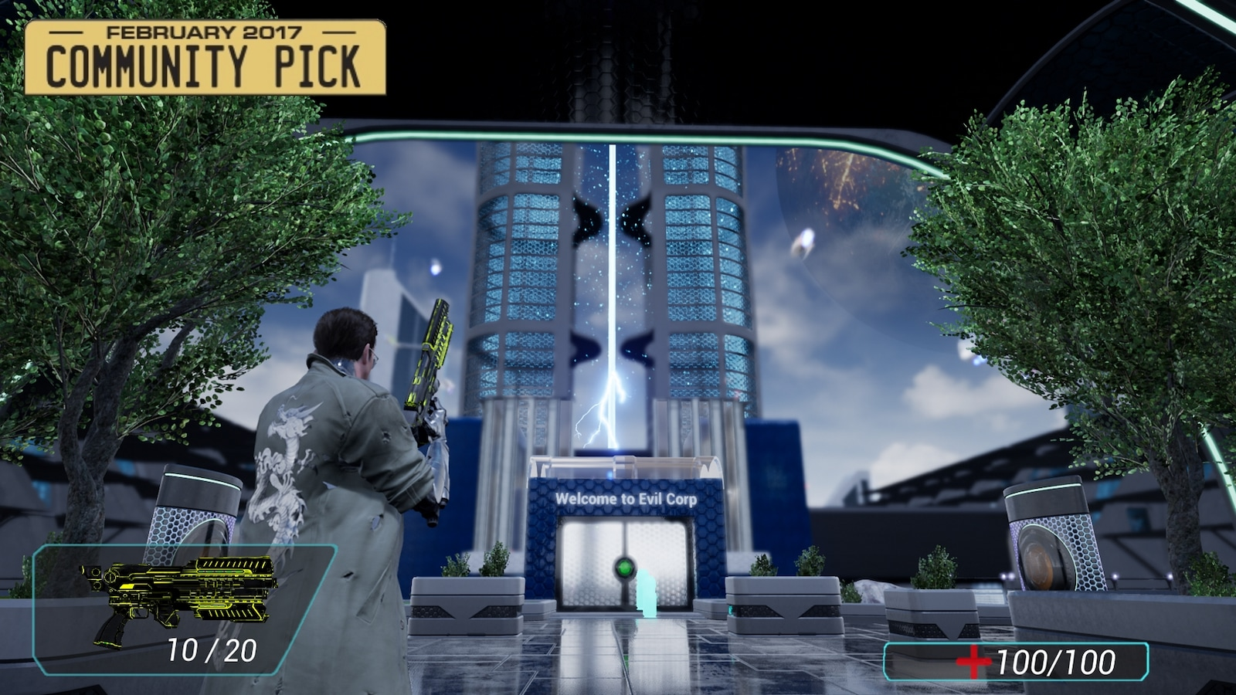
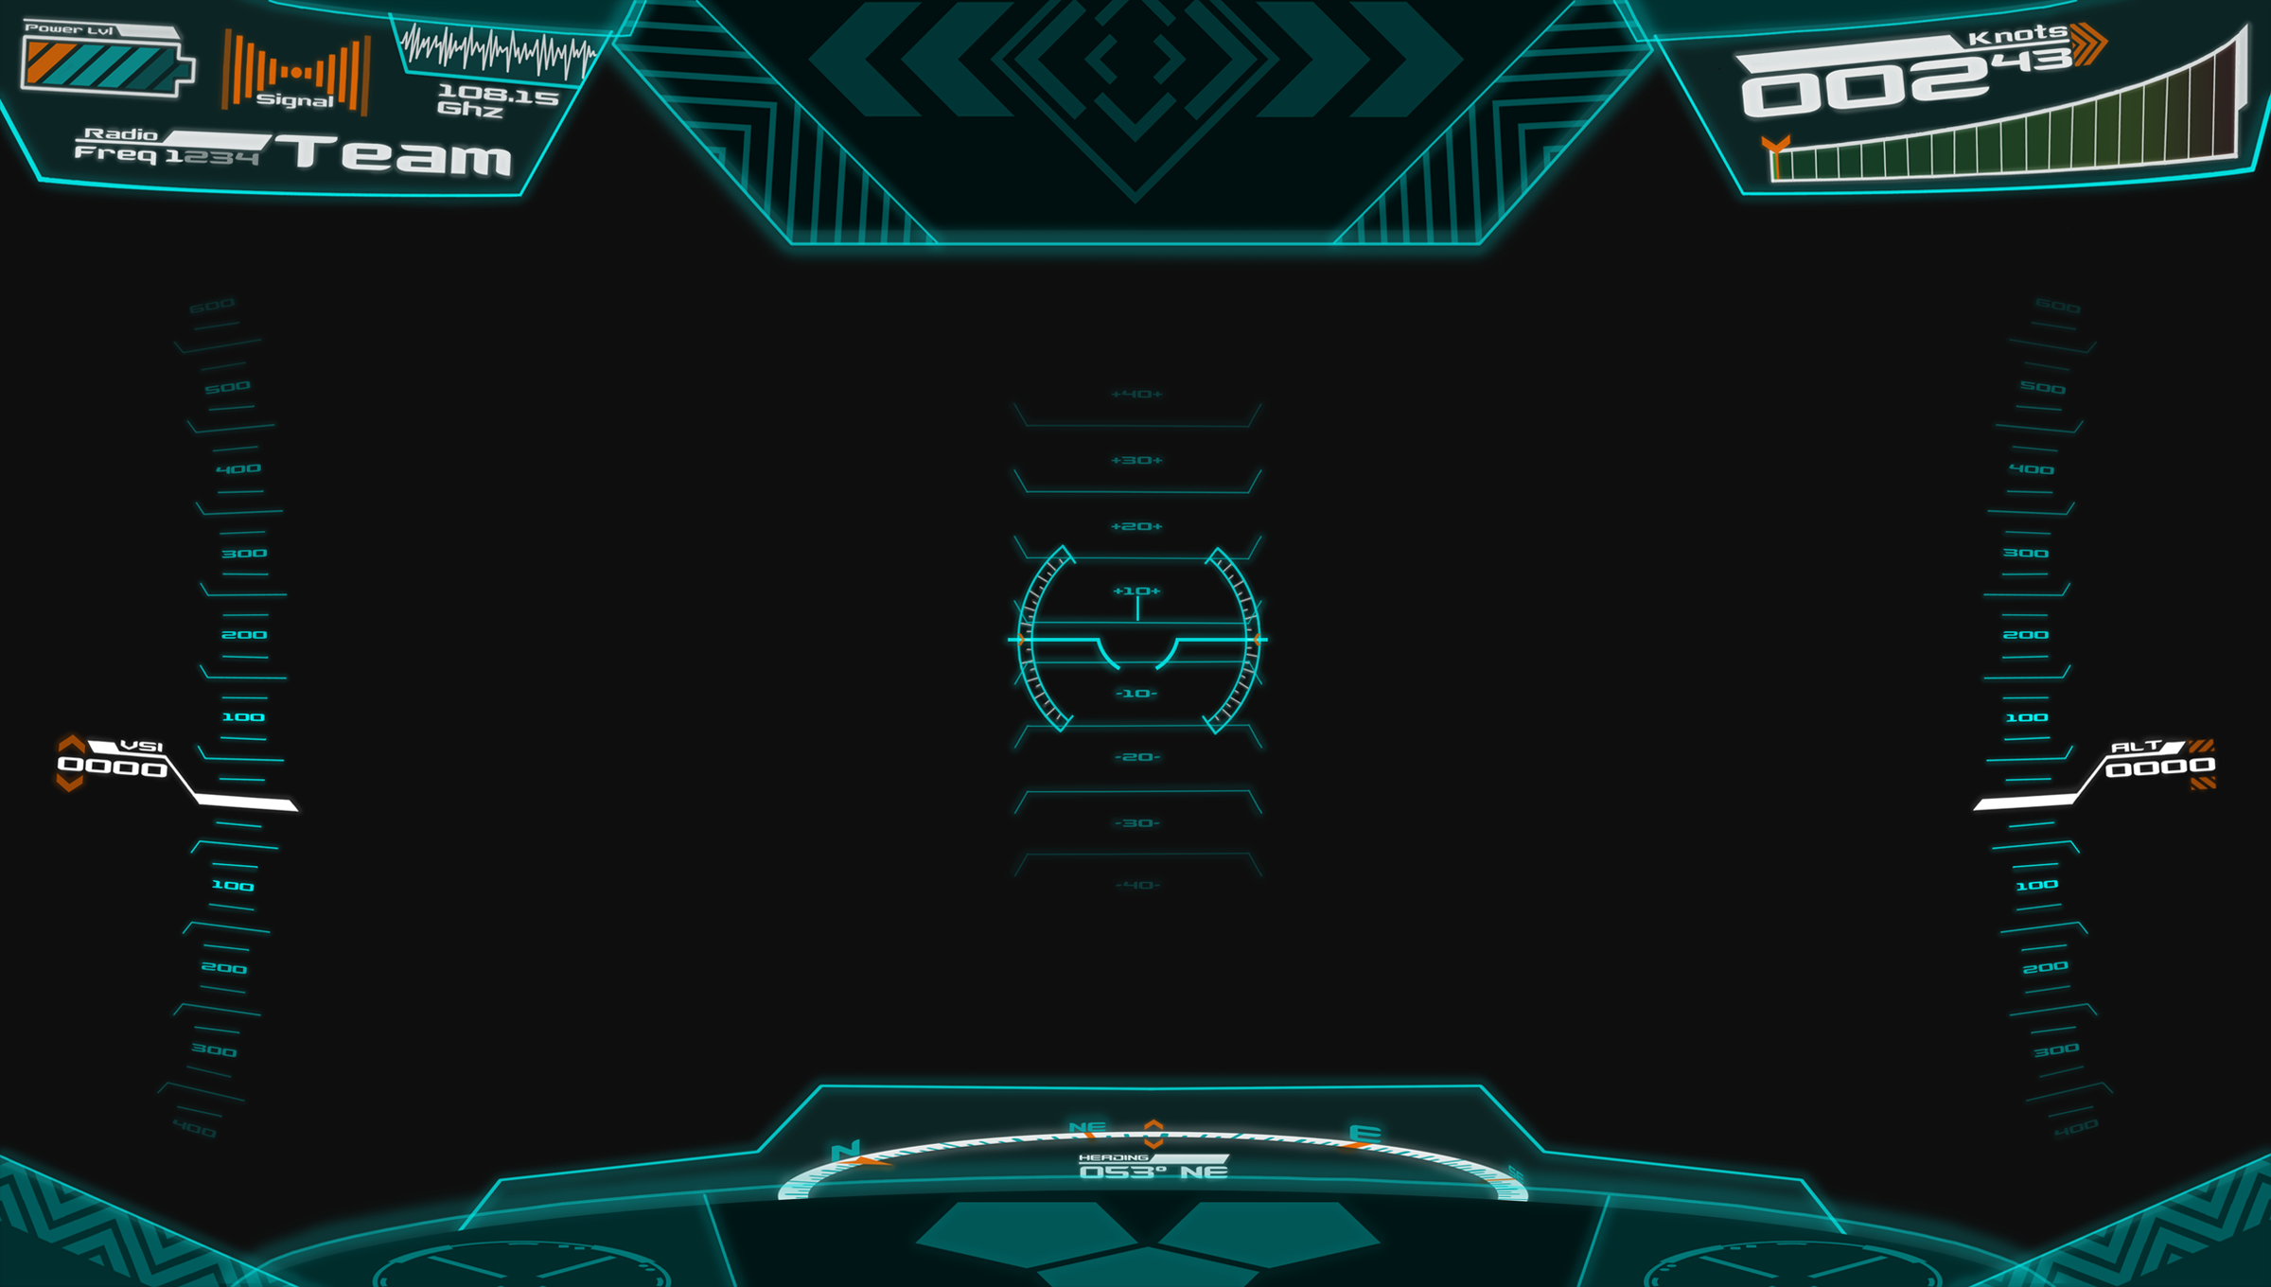
UI Style
Sci-fi UI
Expectant of what would be displayed while wearing a helmet (Diegetic)
Displaying information in bordered polygons
Detailed with straight, coloured lines around camera.

Slide 11

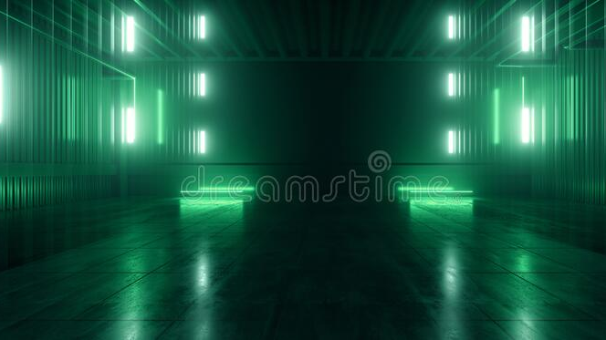
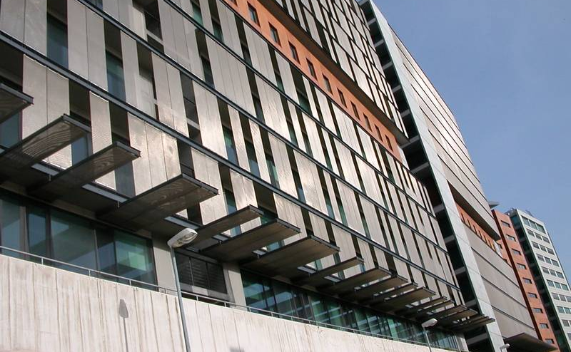
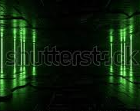
Lighting
Lots of natural lighting
Faint neon green from environment

Slide 12
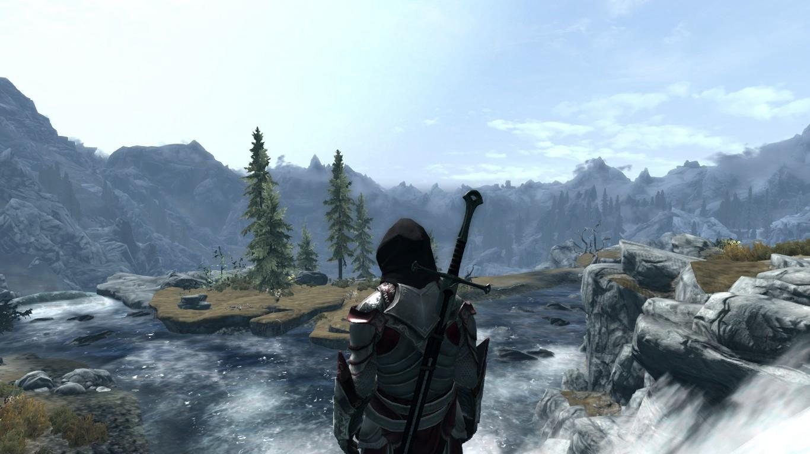
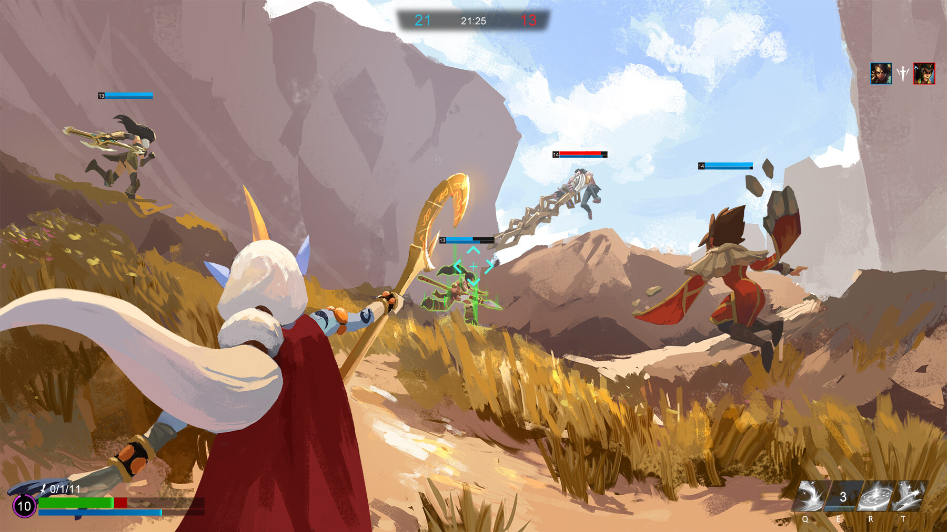
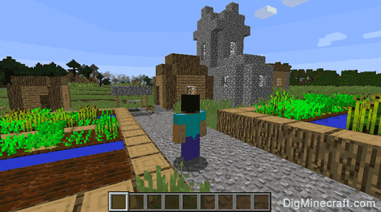
Camera
Third-person perspective

Slide 13
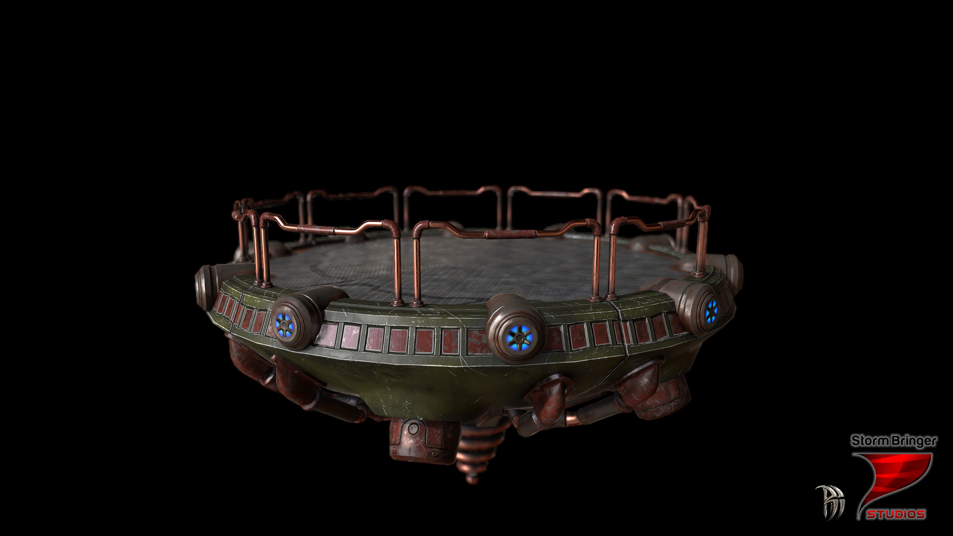
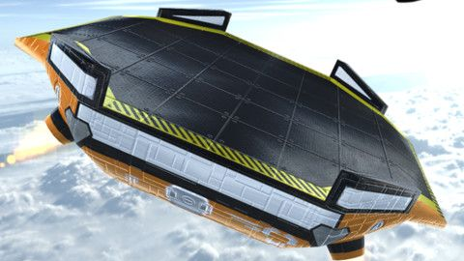
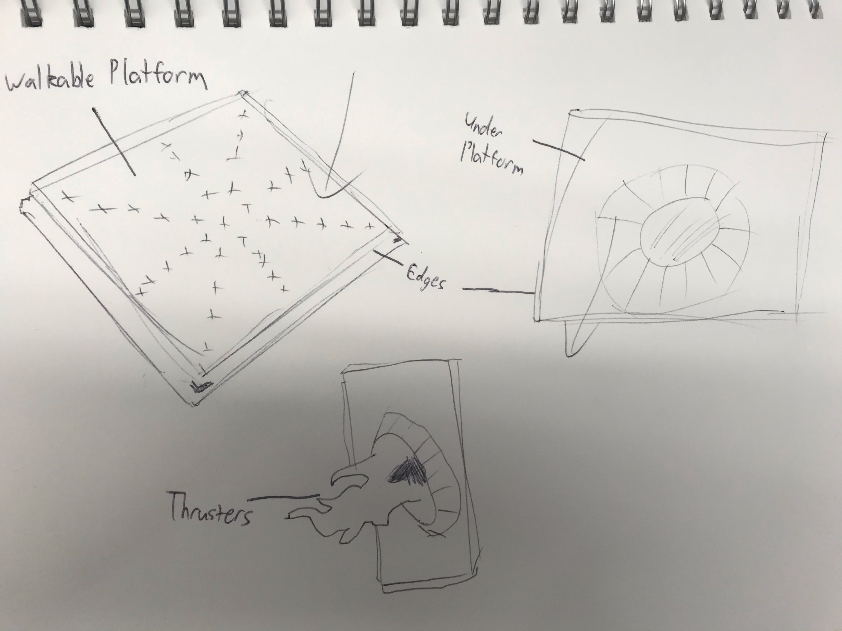
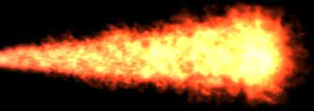
Feature Asset: Concept
A large platform with thrusters on the bottom
Its purpose is to create an additional dynamic by giving the player more options to kill zombies with

Slide 14
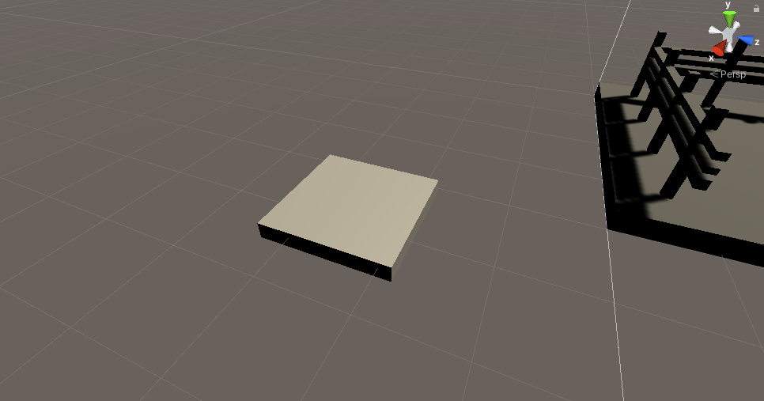
Feature Asset: Grey Box

Slide 15
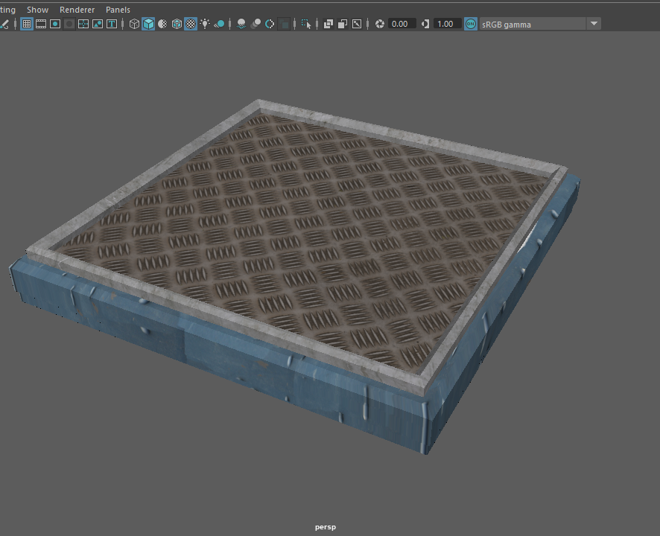
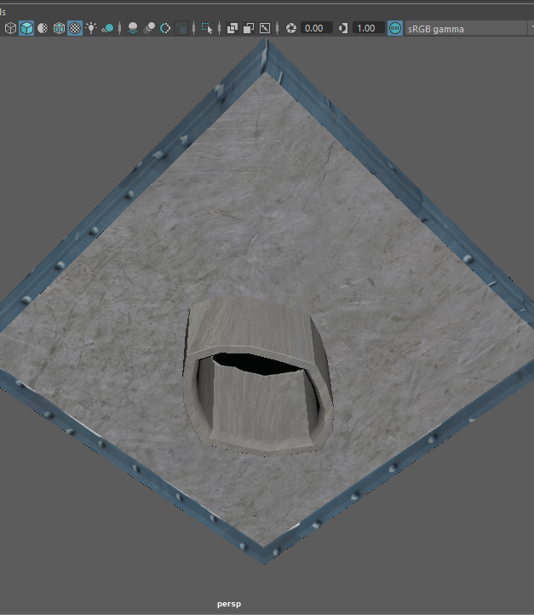
Feature Asset: 1st Pass

Slide 16
Feature Asset: Final Model (textured)

